Slide 1
AI-Powered Legal Document Review System
Enhancing legal reviews through advanced artificial intelligence
Notes:
---

Slide 2
System Architecture
Notes:
---
This slide references information from the following file: https://myoffice.accenture.com/personal/aanchit_govind_accenture_com/Documents/Microsoft%20Copilot%20Chat%20Files/.env.txt,https://myoffice.accenture.com/personal/aanchit_govind_accenture_com/Documents/Microsoft%20Copilot%20Chat%20Files/ingest_to_search.py,https://myoffice.accenture.com/personal/aanchit_govind_accenture_com/Documents/Microsoft%20Copilot%20Chat%20Files/main_agent.py
Overview of System Architecture

Slide 3

Overview of System Architecture
Document Storage and Ingestion
  Azure Blob Storage stores legal documents, which are ingested by a dedicated agent for indexing and retrieval.
Clause Extraction and Summarization
  Azure OpenAI services extract clauses and generate contextually accurate summaries using Retrieval-Augmented Generation.
Agent Orchestration and Monitoring
  Azure AI Foundry manages agent coordination while Azure Monitor tracks decisions and flags anomalies for accountability.
Adaptive Task Planning
  Semantic Kernel enables dynamic task planning and memory retention to enhance agent intelligence and adaptability.
Notes:
---
This slide references information from the following file: https://myoffice.accenture.com/personal/aanchit_govind_accenture_com/Documents/Microsoft%20Copilot%20Chat%20Files/.env.txt,https://myoffice.accenture.com/personal/aanchit_govind_accenture_com/Documents/Microsoft%20Copilot%20Chat%20Files/ingest_to_search.py,https://myoffice.accenture.com/personal/aanchit_govind_accenture_com/Documents/Microsoft%20Copilot%20Chat%20Files/main_agent.py
The AI-Powered Legal Document Review System is designed to automate the process of reviewing legal documents by integrating multiple Azure services and advanced AI components. The architecture is modular and scalable, enabling efficient handling of large volumes of legal data. At the core of the system is Azure Blob Storage, which serves as the primary repository for storing legal documents. These documents are ingested by a dedicated agent that uploads them to Azure Cognitive Search, allowing for efficient indexing and retrieval.
Azure Cognitive Search plays a crucial role in enabling the retrieval of relevant legal clauses and precedents. The system leverages Azure OpenAI services to perform clause extraction and generate grounded summaries using Retrieval-Augmented Generation (RAG). This ensures that the summaries are contextually accurate and based on relevant legal information. The Semantic Kernel is employed to facilitate dynamic task planning and memory retention, enhancing the adaptability and intelligence of the agents.
Agent orchestration is managed through Azure AI Foundry, which coordinates the various agents involved in the document review process. Additionally, Azure Monitor is integrated to track agent decisions and flag anomalies, ensuring transparency and accountability. For advanced monitoring, the system optionally supports telemetry simulation via IoT Hub, which can be used to monitor real-time data and detect irregularities. This comprehensive architecture ensures a robust, intelligent, and responsible approach to legal document review.

Slide 4
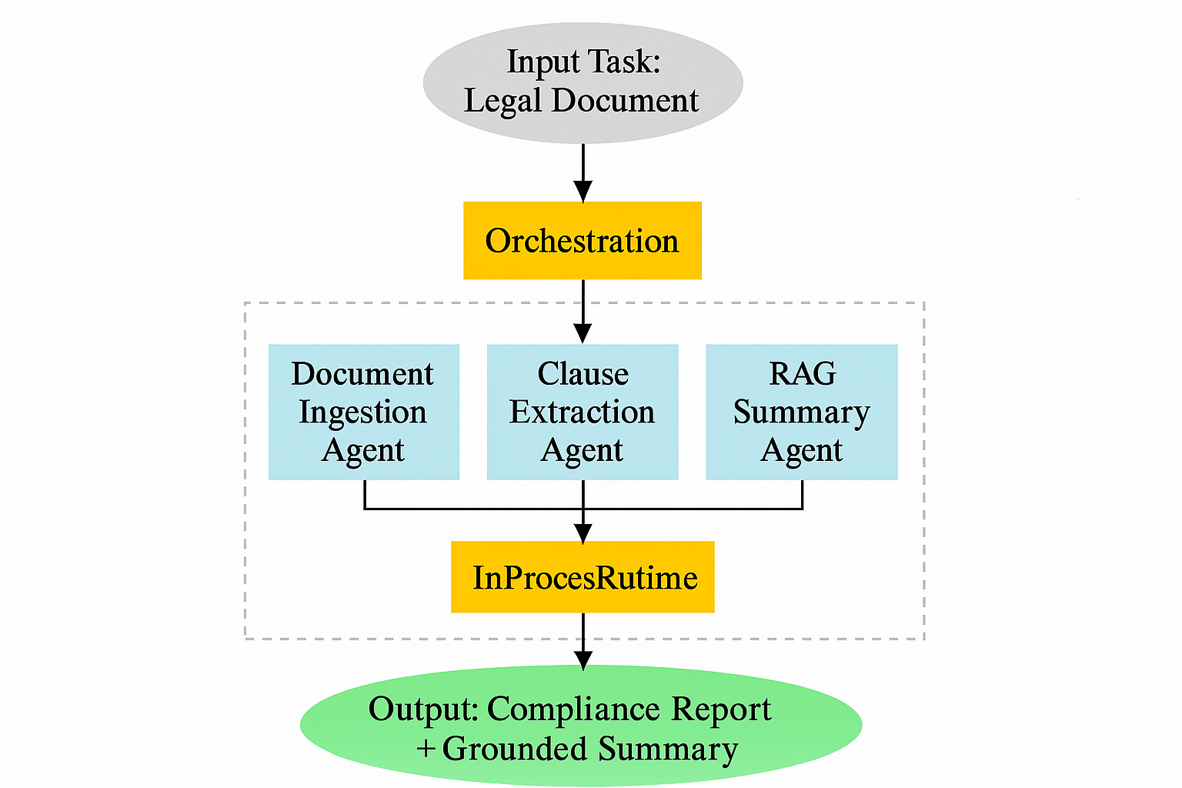

Slide 5
Agent Workflow Overview
Notes:
---
This slide references information from the following file: https://myoffice.accenture.com/personal/aanchit_govind_accenture_com/Documents/Microsoft%20Copilot%20Chat%20Files/.env.txt,https://myoffice.accenture.com/personal/aanchit_govind_accenture_com/Documents/Microsoft%20Copilot%20Chat%20Files/ingest_to_search.py
Multi-Agent Workflow

Slide 6

Multi-Agent Workflow
Document Ingestion and Indexing
  Documents are downloaded from cloud storage and indexed for quick retrieval using cognitive search services.
Clause Extraction Using AI
  AI analyzes text to extract legal clauses by leveraging advanced language models for precise identification.
Compliance Validation
  Extracted clauses are evaluated for compliance risks with confidence scores highlighting high-risk issues.
Contextual Retrieval and Summarization
  Similar clauses are retrieved to provide context, and summaries are generated to aid legal review.
Notes:
---
This slide references information from the following file: https://myoffice.accenture.com/personal/aanchit_govind_accenture_com/Documents/Microsoft%20Copilot%20Chat%20Files/.env.txt,https://myoffice.accenture.com/personal/aanchit_govind_accenture_com/Documents/Microsoft%20Copilot%20Chat%20Files/ingest_to_search.py
The AI-Powered Legal Document Review System employs a multi-agent architecture to streamline the processing of legal documents. The workflow begins with the Document Ingestion Agent, which connects to Azure Blob Storage to download legal documents. These documents are then uploaded to Azure Cognitive Search, where they are indexed for efficient retrieval.
Next, the Clause Extraction Agent utilizes Azure OpenAI services to analyze the text and identify legal clauses. This agent sends the document content to a GPT-based model, which returns a list of extracted clauses. Each clause is then passed to the Compliance Validation Agent, which evaluates the clause for potential compliance issues. The agent uses OpenAI to analyze the clause and returns flagged issues along with a confidence score, ensuring that only high-risk clauses are highlighted.
Following validation, the Retrieval Agent queries Azure Cognitive Search to find similar clauses from previously ingested documents. This step provides contextual grounding for the final analysis. The Summary Agent then uses the retrieved clauses and the original query to generate a comprehensive summary using Retrieval-Augmented Generation (RAG). This summary helps legal professionals quickly understand the compliance landscape of the document. The entire workflow is orchestrated using Azure AI Foundry, which ensures seamless communication and coordination among the agents.

